Slide 1
Chapter 5: CPU Scheduling

Slide 2
Outline
Basic Concepts
Scheduling Criteria
Scheduling Algorithms
Thread Scheduling
Multi-Processor Scheduling
Real-Time CPU Scheduling

Slide 3
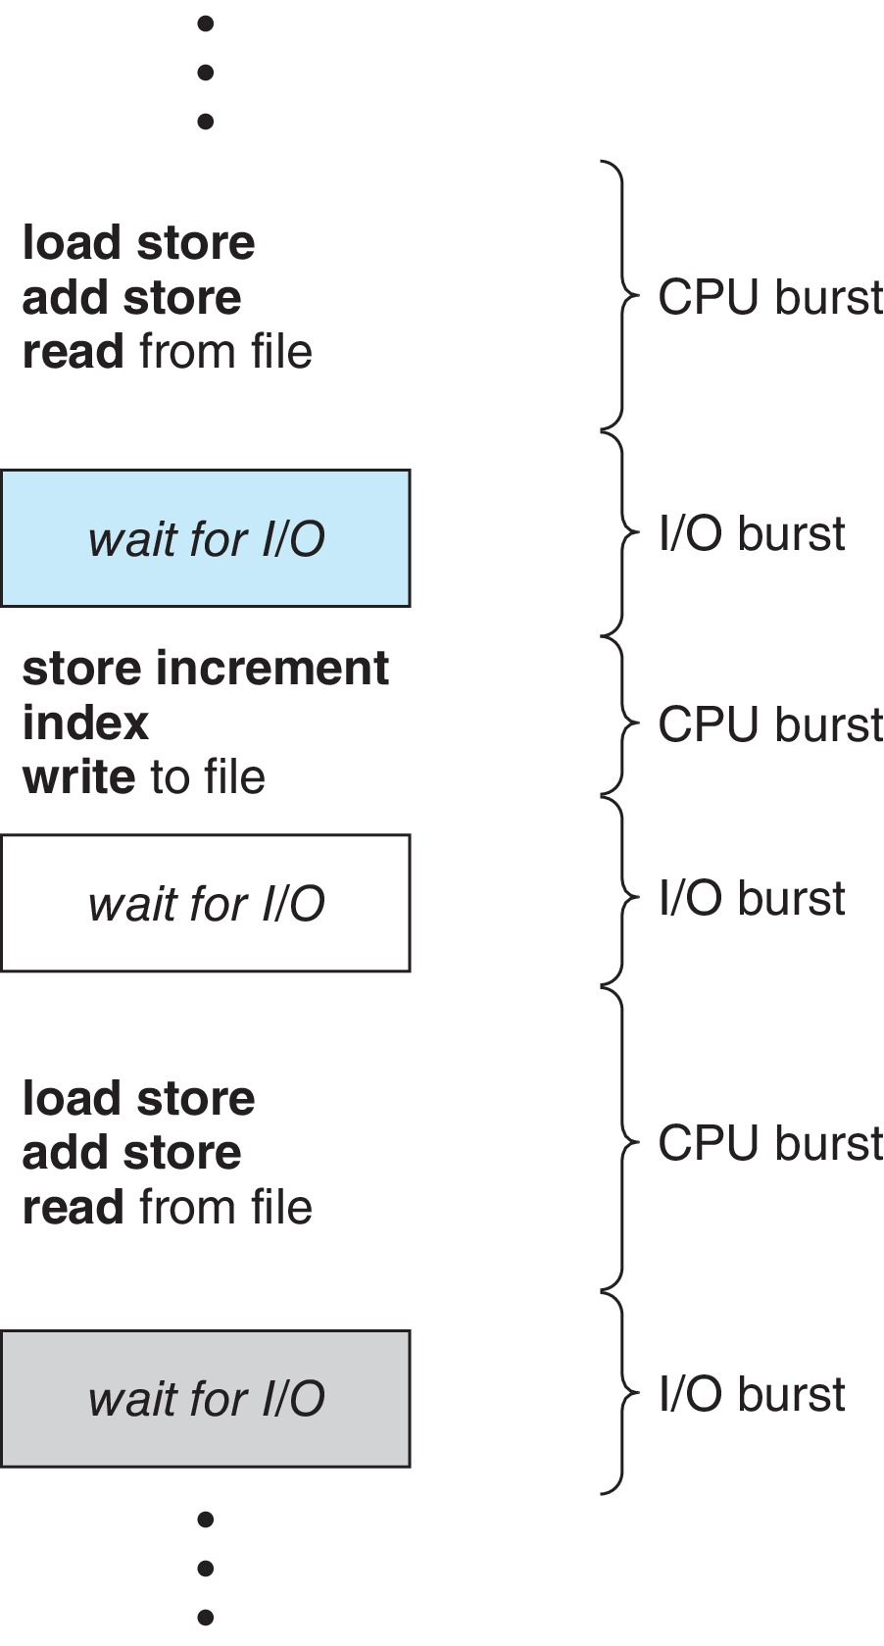
Basic Concepts
Maximum CPU utilization obtained with multiprogramming
CPU–I/O Burst Cycle – Process execution consists of a cycle of CPU execution and I/O wait
CPU burst followed by I/O burst
CPU burst distribution is of main concern

Slide 4
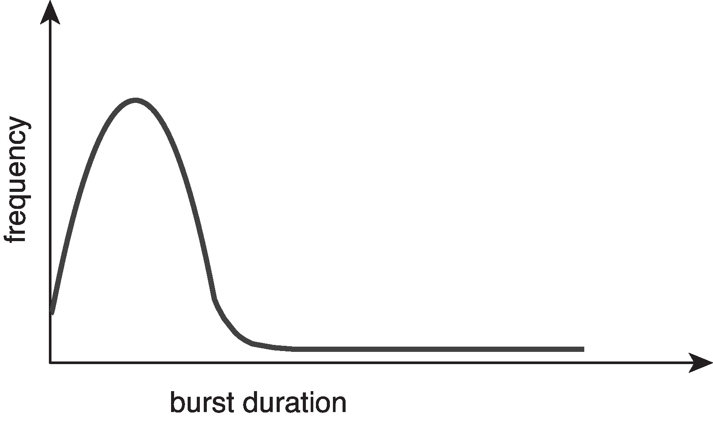
Histogram of CPU-burst Times
Large number of short bursts
Small number of longer bursts

Slide 5
CPU Scheduler
The CPU scheduler selects from among the processes in ready queue, and allocates a CPU core to one of them
Queue may be ordered in various ways
CPU scheduling decisions may take place when a process:
1. Switches from running to waiting state
2. Switches from running to ready state
3. Switches from waiting to ready
Terminates
For situations 1 and 4, there is no choice in terms of scheduling. A new process (if one exists in the ready queue) must be selected for execution.
For situations 2 and 3, however, there is a choice.

Slide 6
Preemptive and Nonpreemptive Scheduling
When scheduling takes place only under circumstances 1 and 4, the scheduling scheme is nonpreemptive.
Otherwise, it is preemptive.
Under Nonpreemptive scheduling, once the CPU has been allocated to a process, the process keeps the CPU until it releases it either by terminating or by switching to the waiting state.
Virtually all modern operating systems including Windows, MacOS, Linux, and UNIX use preemptive scheduling algorithms.

Slide 7
Preemptive Scheduling and Race Conditions
Preemptive scheduling can result in race conditions when data are shared among several processes.
one process is updating the data, it is preempted so that the second process can run. The second process then tries to read the data, which are in an inconsistent state.
example

Slide 8
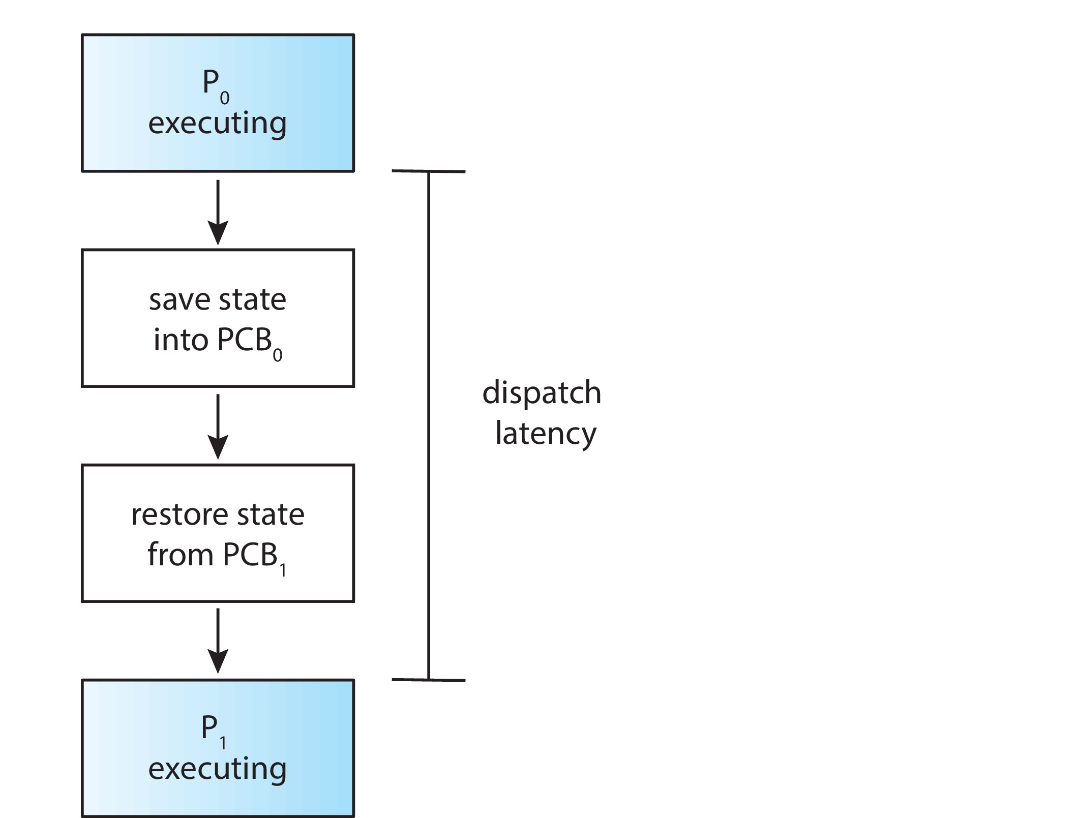
Dispatcher
Dispatcher module gives control of the CPU to the process selected by the CPU scheduler; this involves:
Switching context
Switching to user mode
Jumping to the proper location in the user program to restart that program
Dispatch latency – time it takes for the dispatcher to stop one process and start another running

Slide 9
Scheduling Criteria
CPU utilization – keep the CPU as busy as possible
Throughput – # of processes that complete their execution per time unit
Turnaround time – amount of time to execute a particular process
Waiting time – amount of time a process has been waiting in the ready queue
Response time – amount of time it takes from when a request was submitted until the first response is produced.

Slide 10
Scheduling Algorithm Optimization Criteria
Max CPU utilization
Max throughput
Min turnaround time
Min waiting time
Min response time

Slide 11
First- Come, First-Served (FCFS) Scheduling
Process Burst Time
P₁ 24
P₂ 3
P₃ 3
Suppose that the processes arrive in the order: P₁ , P₂ , P₃ The Gantt Chart for the schedule is:
Waiting time for P₁ = 0; P₂ = 24; P₃ = 27
Average waiting time: (0 + 24 + 27)/3 = 17

Slide 12
FCFS Scheduling (Cont.)
Suppose that the processes arrive in the order:
P₂ , P₃ , P₁
The Gantt chart for the schedule is:
Waiting time for P₁ = 6; P₂ = 0; P₃ = 3
Average waiting time: (6 + 0 + 3)/3 = 3
Much better than previous case
Convoy effect - short process behind long process
Consider one CPU-bound and many I/O-bound processes

Slide 13
Shortest-Job-First (SJF) Scheduling
Associate with each process the length of its next CPU burst
Use these lengths to schedule the process with the shortest time
SJF is optimal – gives minimum average waiting time for a given set of processes
Preemptive version called shortest-remaining-time-first
How do we determine the length of the next CPU burst?
Could ask the user
Estimate

Slide 14
Example of SJF
ProcessArrival Time Burst Time
P₁ 0.0 6
P₂ 2.0 8
P₃ 4.0 7
P₄ 5.0 3
SJF scheduling chart
Average waiting time = (3 + 16 + 9 + 0) / 4 = 7

Slide 15

Determining Length of Next CPU Burst
Can only estimate the length – should be similar to the previous one
Then pick process with shortest predicted next CPU burst
Can be done by using the length of previous CPU bursts, using exponential averaging
Commonly, α set to ½

Slide 16
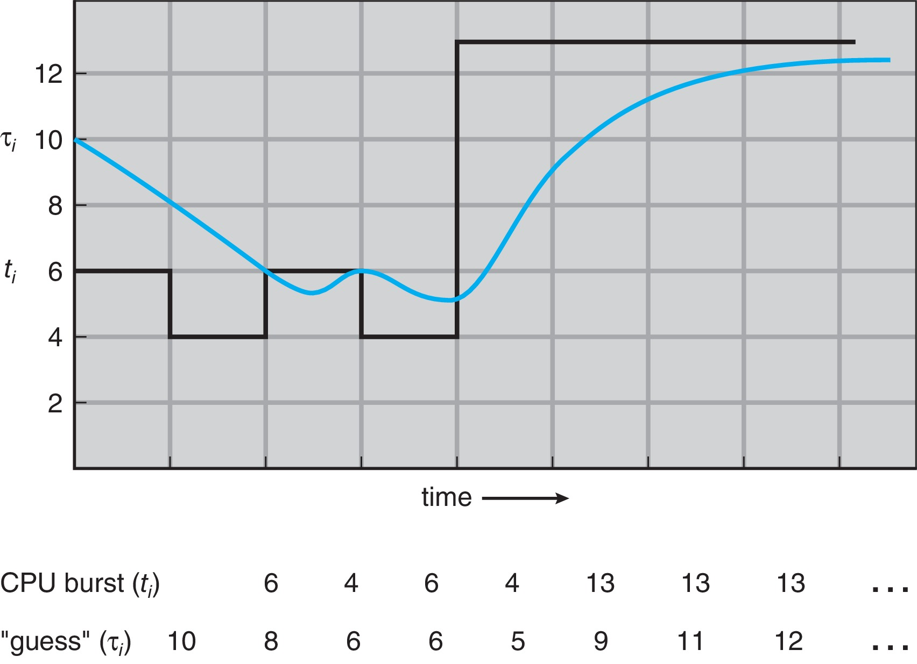
Prediction of the Length of the Next CPU Burst

Slide 17
Examples of Exponential Averaging
α =0
τ_{n+1} = τ_{n}
Recent history does not count
α =1
τ_{n+1} = α t_{n}
Only the actual last CPU burst counts
If we expand the formula, we get:
τ_{n+1} = α t_{n}+(1 - α)α t_{n} ₋₁ + …
+(1 - α )^{j} α t_{n} _{-j} + …
+(1 - α )^{n +1} τ₀
Since both α and (1 - α) are less than or equal to 1, each successive term has less weight than its predecessor

Slide 18
Example of Shortest-remaining-time-first
Now we add the concepts of varying arrival times and preemption to the analysis
ProcessA arri Arrival TimeT Burst Time
P₁ 0 8
P₂ 1 4
P₃ 2 9
P₄ 3 5
Preemptive SJF Gantt Chart
Average waiting time = [(10-1)+(1-1)+(17-2)+(5-3)]/4 = 26/4 = 6.5

Slide 19
Round Robin (RR)
Each process gets a small unit of CPU time (time quantum q), usually 10-100 milliseconds. After this time has elapsed, the process is preempted and added to the end of the ready queue.
If there are n processes in the ready queue and the time quantum is q, then each process gets 1/n of the CPU time in chunks of at most q time units at once. No process waits more than (n-1)q time units.
Timer interrupts every quantum to schedule next process
Performance
q large ⇒ FIFO
q small ⇒ q must be large with respect to context switch, otherwise overhead is too high

Slide 20
Example of RR with Time Quantum = 4
Process Burst Time
P₁ 24
P₂ 3
P₃ 3
The Gantt chart is:
Typically, higher average turnaround than SJF, but better response
q should be large compared to context switch time
q usually 10 milliseconds to 100 milliseconds,
Context switch < 10 microseconds

Slide 21
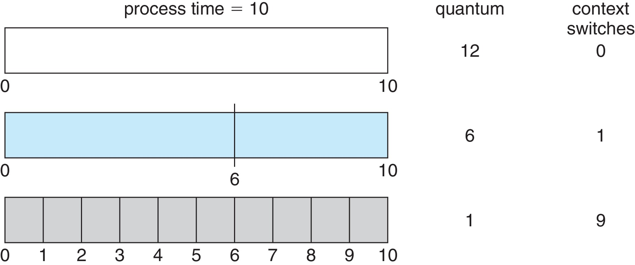
Time Quantum and Context Switch Time

Slide 22
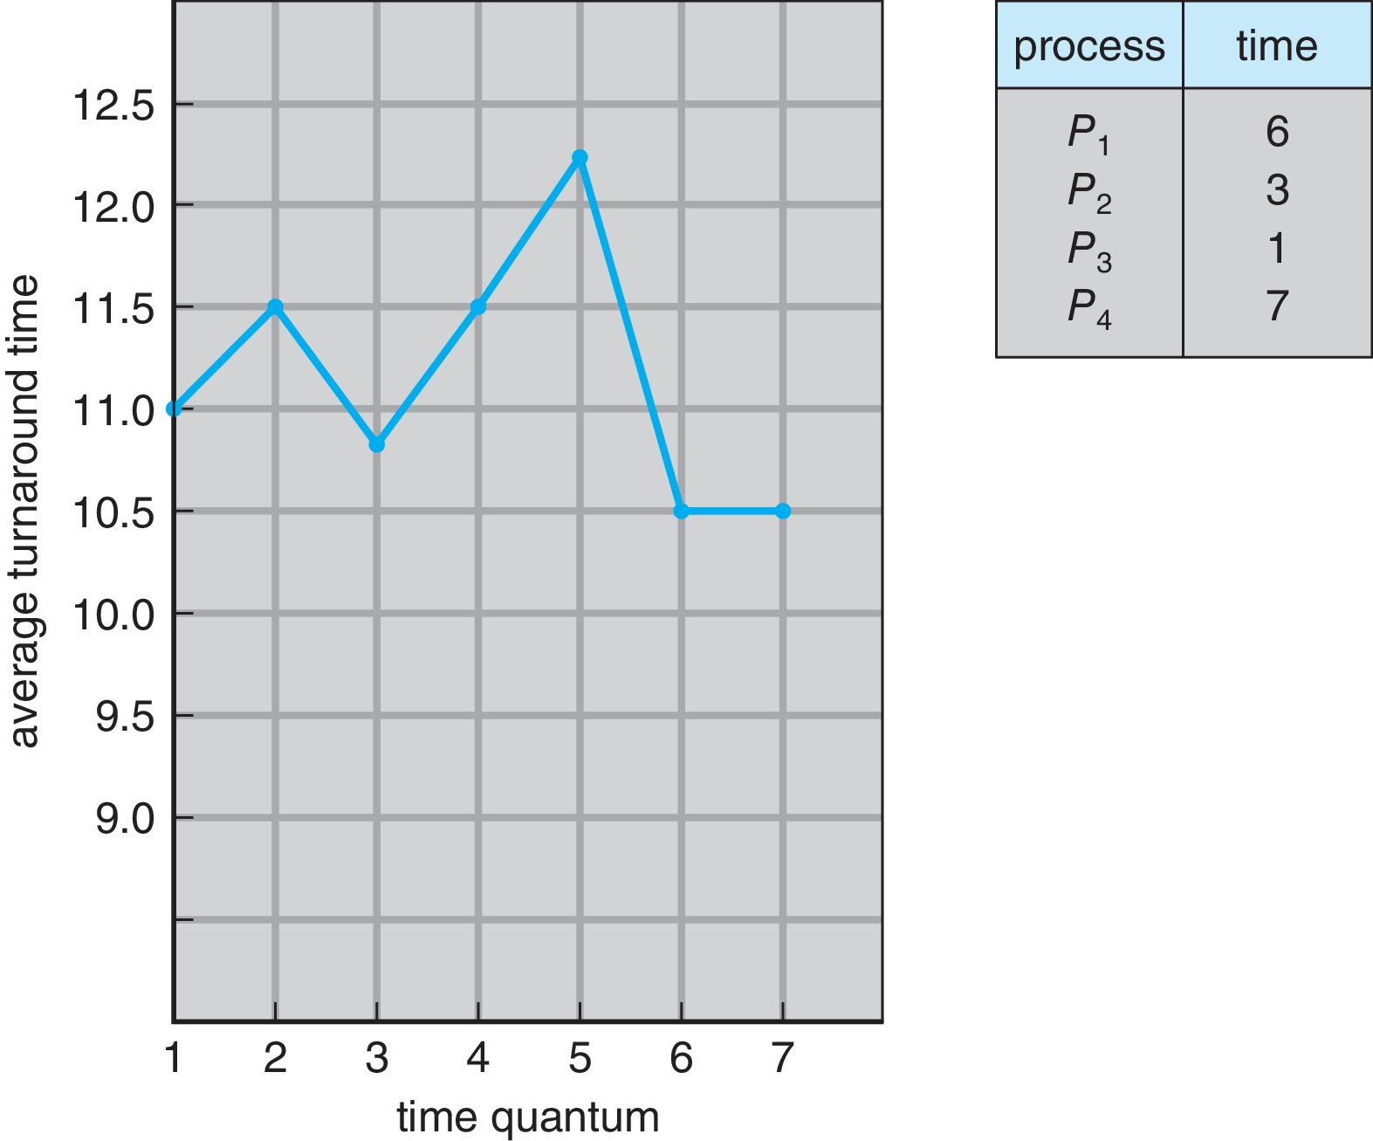
Turnaround Time Varies With The Time Quantum
80% of CPU bursts should be shorter than q

Slide 23
Priority Scheduling
A priority number (integer) is associated with each process
The CPU is allocated to the process with the highest priority (smallest integer ≡ highest priority)
Preemptive
Nonpreemptive
SJF is priority scheduling where priority is the inverse of predicted next CPU burst time
Problem ≡ Starvation – low priority processes may never execute
Solution ≡ Aging – as time progresses increase the priority of the process

Slide 24
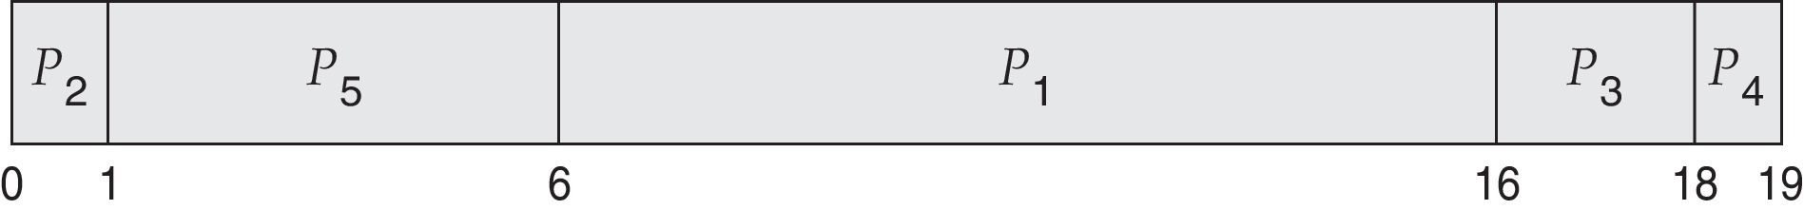
Example of Priority Scheduling
ProcessA arri Burst TimeT Priority
P₁ 10 3
P₂ 1 1
P₃ 2 4
P₄ 1 5
P₅ 5 2
Priority scheduling Gantt Chart
Average waiting time = 8.2

Slide 25
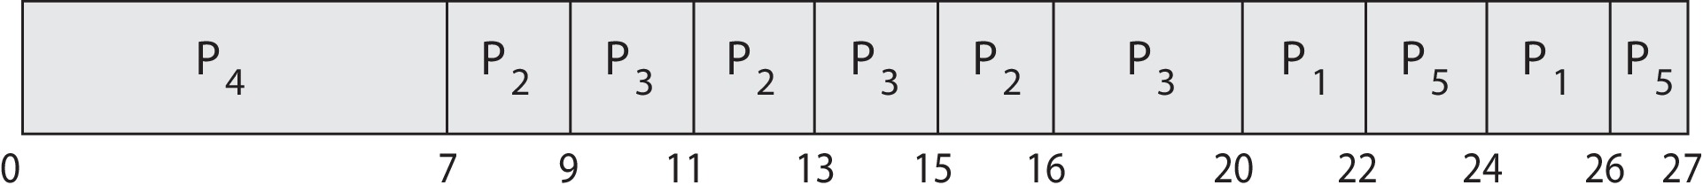
Priority Scheduling w/ Round-Robin
ProcessA arri Burst TimeT Priority
P₁ 4 3
P₂ 5 2
P₃ 8 2
P₄ 7 1
P₅ 3 3
Run the process with the highest priority. Processes with the same priority run round-robin
Gantt Chart with time quantum = 2

Slide 26
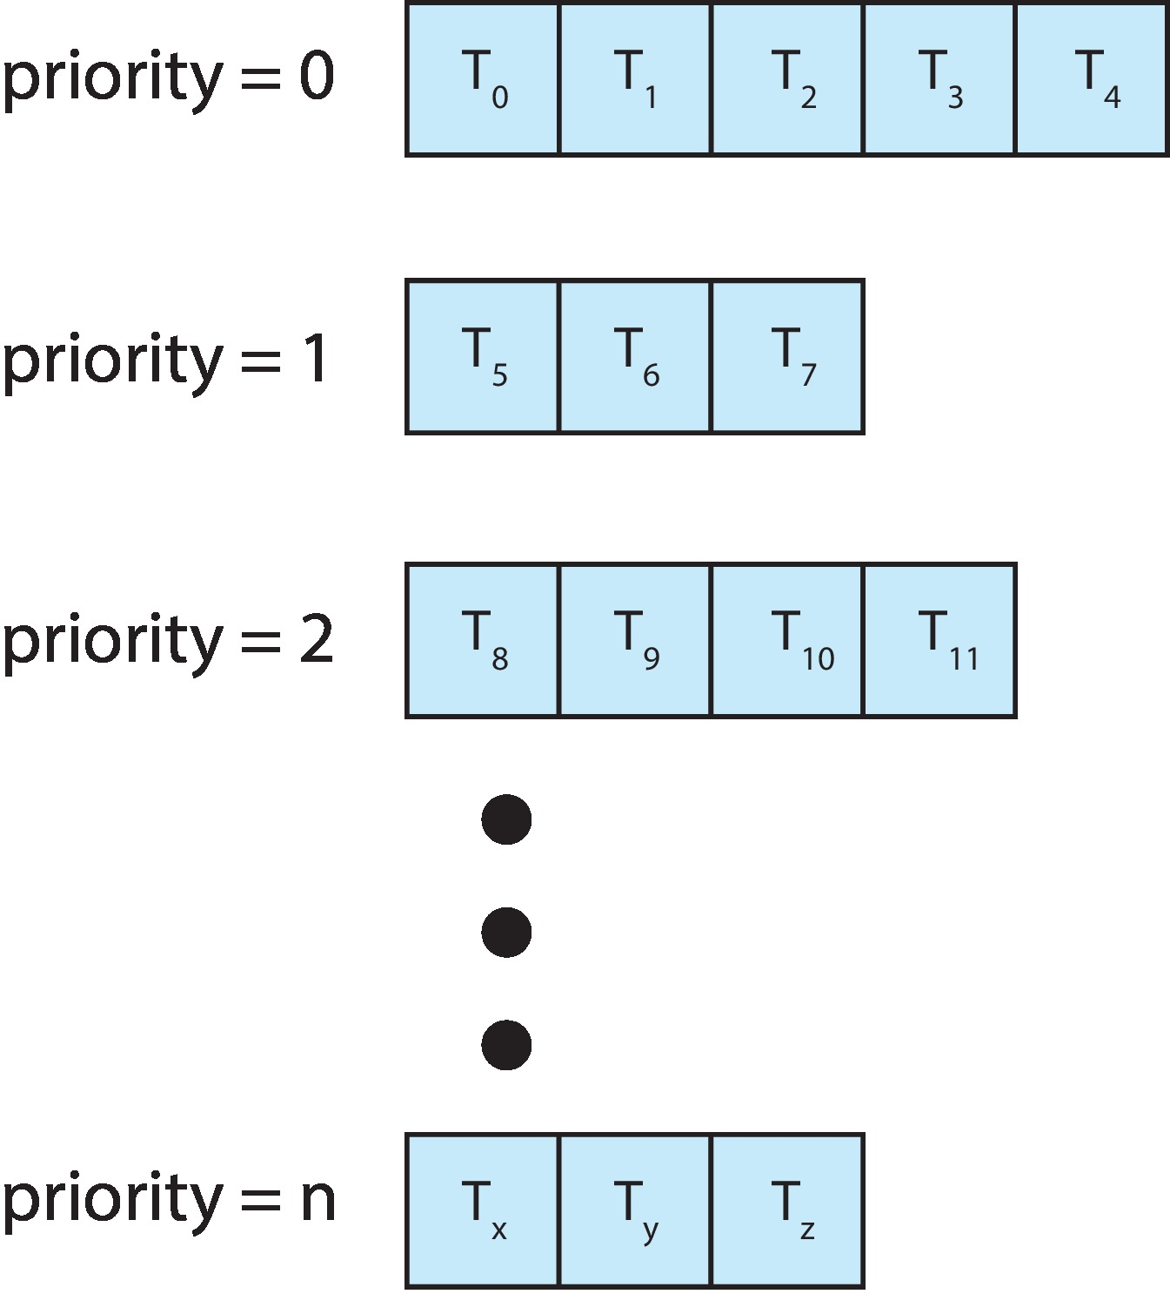
Multilevel Queue
With priority scheduling, have separate queues for each priority.
Schedule the process in the highest-priority queue!

Slide 27
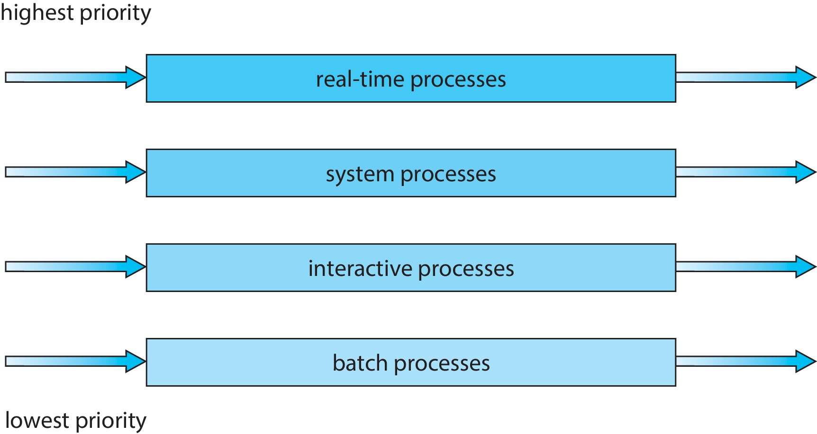
Multilevel Queue
Prioritization based upon process type

Slide 28
Multilevel Feedback Queue
A process can move between the various queues.
Multilevel-feedback-queue scheduler defined by the following parameters:
Number of queues
Scheduling algorithms for each queue
Method used to determine when to upgrade a process
Method used to determine when to demote a process
Method used to determine which queue a process will enter when that process needs service
Aging can be implemented using multilevel feedback queue

Slide 29
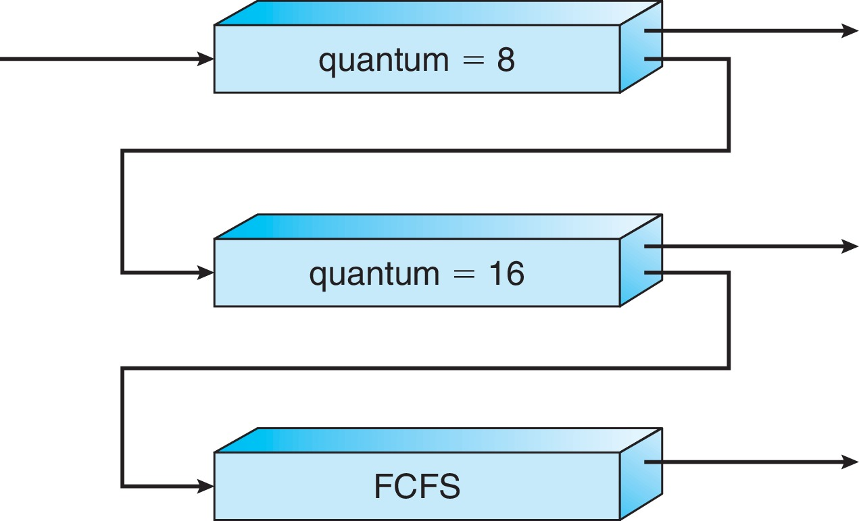
Example of Multilevel Feedback Queue
Three queues:
Q₀ – RR with time quantum 8 milliseconds
Q₁ – RR time quantum 16 milliseconds
Q₂ – FCFS
Scheduling
A new process enters queue Q₀ which is served in RR
When it gains CPU, the process receives 8 milliseconds
If it does not finish in 8 milliseconds, the process is moved to queue Q₁
At Q₁ job is again served in RR and receives 16 additional milliseconds
If it still does not complete, it is preempted and moved to queue Q₂

Slide 30
Thread Scheduling
Distinction between user-level and kernel-level threads
When threads supported, threads scheduled, not processes
Many-to-one and many-to-many models, thread library schedules user-level threads to run on LWP
Known as process-contention scope (PCS) since scheduling competition is within the process
Typically done via priority set by programmer
Kernel thread scheduled onto available CPU is system-contention scope (SCS) – competition among all threads in system

Slide 31
Pthread Scheduling
API allows specifying either PCS or SCS during thread creation
PTHREAD_SCOPE_PROCESS schedules threads using PCS scheduling
PTHREAD_SCOPE_SYSTEM schedules threads using SCS scheduling
Can be limited by OS – Linux and macOS only allow PTHREAD_SCOPE_SYSTEM

Slide 32
Pthread Scheduling API
#include <pthread.h>
#include <stdio.h>
#define NUM_THREADS 5
int main(int argc, char *argv[]) {
int i, scope; pthread_t tid[NUM THREADS];
pthread_attr_t attr;
/* get the default attributes */
pthread_attr_init(&attr);
/* first inquire on the current scope */ if (pthread_attr_getscope(&attr, &scope) != 0)
fprintf(stderr, "Unable to get scheduling scope\n");
else {
if (scope == PTHREAD_SCOPE_PROCESS)
printf("PTHREAD_SCOPE_PROCESS");
else if (scope == PTHREAD_SCOPE_SYSTEM)
printf("PTHREAD_SCOPE_SYSTEM");
else fprintf(stderr, "Illegal scope value.\n");
}

Slide 33
Pthread Scheduling API
/* set the scheduling algorithm to PCS or SCS */
pthread_attr_setscope(&attr, PTHREAD_SCOPE_SYSTEM);
/* create the threads */ for (i = 0; i < NUM_THREADS; i++)
pthread_create(&tid[i],&attr,runner,NULL);
/* now join on each thread */ for (i = 0; i < NUM_THREADS; i++)
pthread_join(tid[i], NULL);
}
/* Each thread will begin control in this function */
void *runner(void *param) {
/* do some work ... */
pthread_exit(0);
}

Slide 34
Multiple-Processor Scheduling
CPU scheduling more complex when multiple CPUs are available
Multiprocess may be any one of the following architectures:
Multicore CPUs
Multithreaded cores
NUMA systems
Heterogeneous multiprocessing

Slide 35
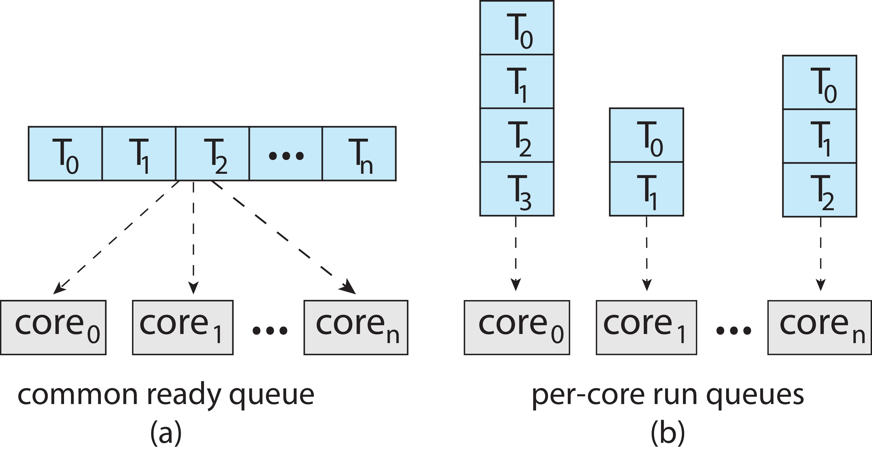
Multiple-Processor Scheduling
Symmetric multiprocessing (SMP) is where each processor is self scheduling.
All threads may be in a common ready queue (a)
Each processor may have its own private queue of threads (b)

Slide 36
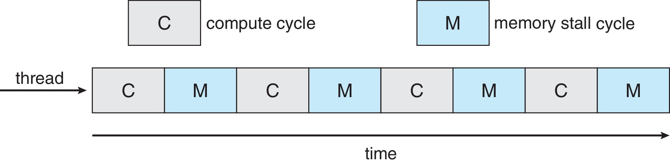
Multicore Processors
Recent trend to place multiple processor cores on same physical chip
Faster and consumes less power
Multiple threads per core also growing
Takes advantage of memory stall to make progress on another thread while memory retrieve happens
Figure

Slide 37
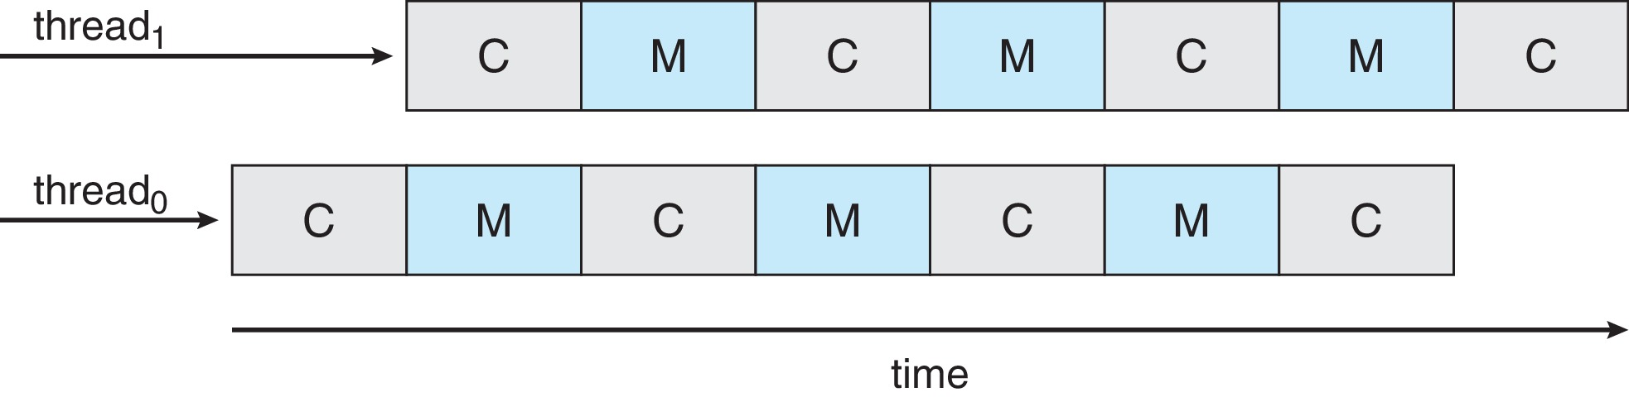
Multithreaded Multicore System
Each core has > 1 hardware threads.
If one thread has a memory stall, switch to another thread!
Figure

Slide 38
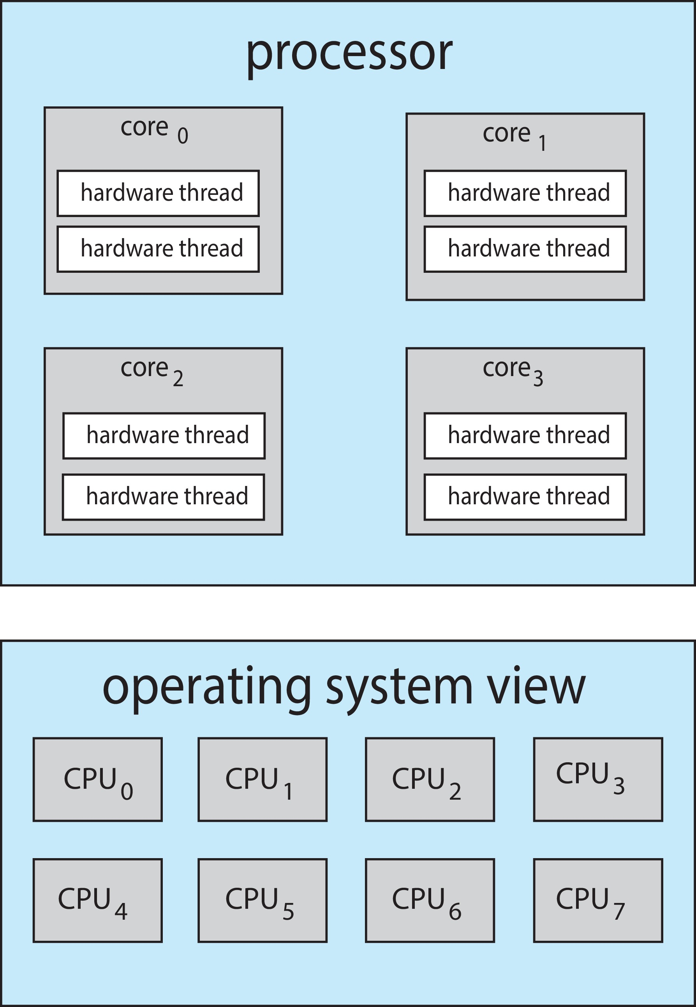
Multithreaded Multicore System
Chip-multithreading (CMT) assigns each core multiple hardware threads. (Intel refers to this as hyperthreading.)
On a quad-core system with 2 hardware threads per core, the operating system sees 8 logical processors.

Slide 39
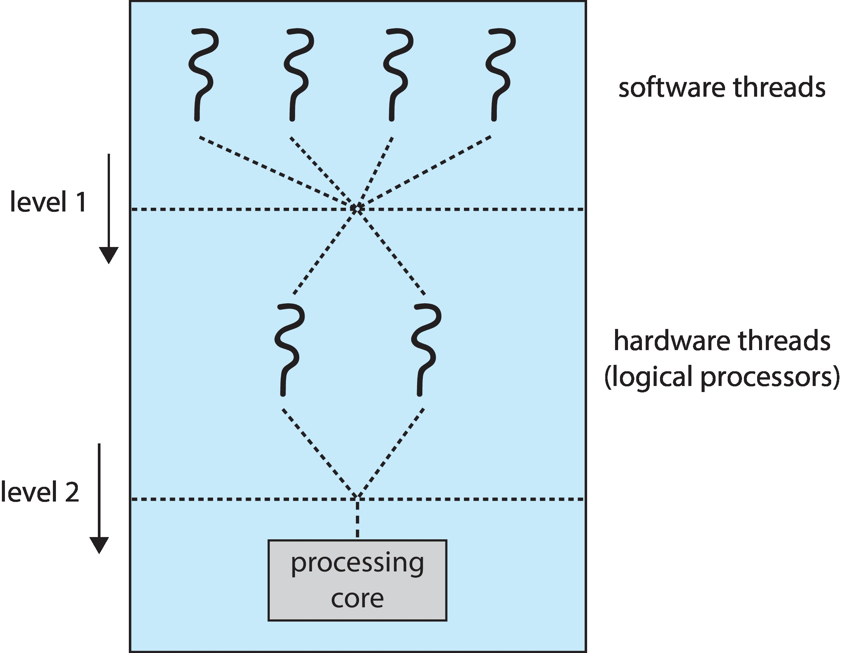
Multithreaded Multicore System
Two levels of scheduling:
The operating system deciding which software thread to run on a logical CPU
How each core decides which hardware thread to run on the physical core.

Slide 40
Multiple-Processor Scheduling – Load Balancing
If SMP, need to keep all CPUs loaded for efficiency
Load balancing attempts to keep workload evenly distributed
Push migration – periodic task checks load on each processor, and if found pushes task from overloaded CPU to other CPUs
Pull migration – idle processors pulls waiting task from busy processor

Slide 41
Multiple-Processor Scheduling – Processor Affinity
When a thread has been running on one processor, the cache contents of that processor stores the memory accesses by that thread.
We refer to this as a thread having affinity for a processor (i.e., “processor affinity”)
Load balancing may affect processor affinity as a thread may be moved from one processor to another to balance loads, yet that thread loses the contents of what it had in the cache of the processor it was moved off of.
Soft affinity – the operating system attempts to keep a thread running on the same processor, but no guarantees.
Hard affinity – allows a process to specify a set of processors it may run on.

Slide 42
NUMA and CPU Scheduling
If the operating system is NUMA-aware, it will assign memory closes to the CPU the thread is running on.

Slide 43
Real-Time CPU Scheduling
Can present obvious challenges
Soft real-time systems – Critical real-time tasks have the highest priority, but no guarantee as to when tasks will be scheduled
Hard real-time systems – task must be serviced by its deadline

Slide 44
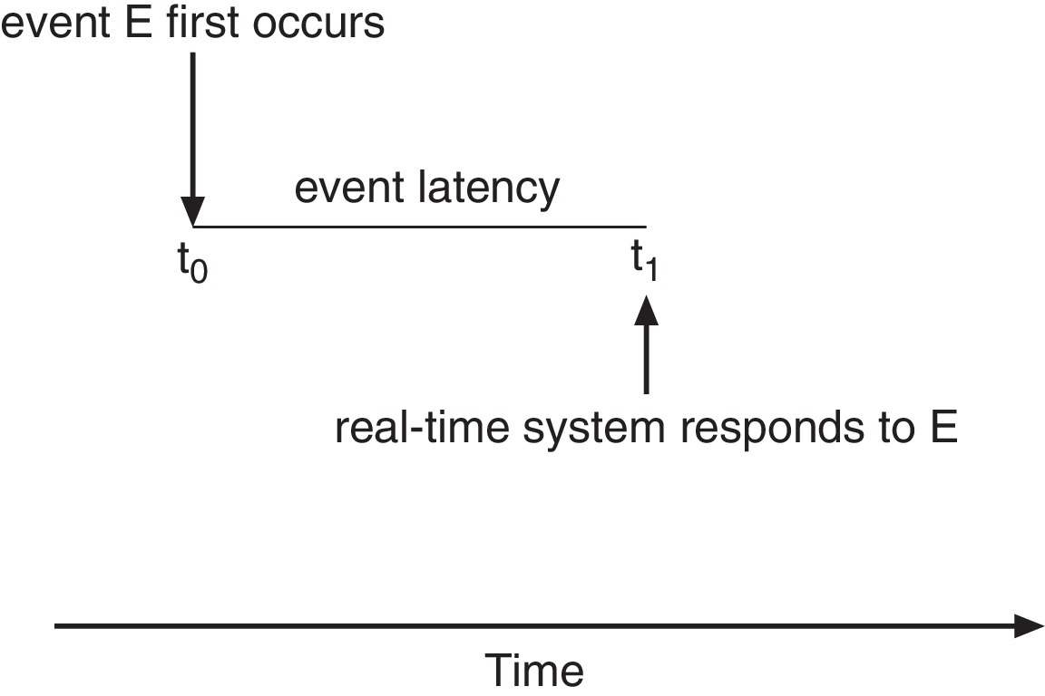
Real-Time CPU Scheduling
Event latency – the amount of time that elapses from when an event occurs to when it is serviced.
Two types of latencies affect performance
Interrupt latency – time from arrival of interrupt to start of routine that services interrupt
Dispatch latency – time for schedule to take current process off CPU and switch to another

Slide 45
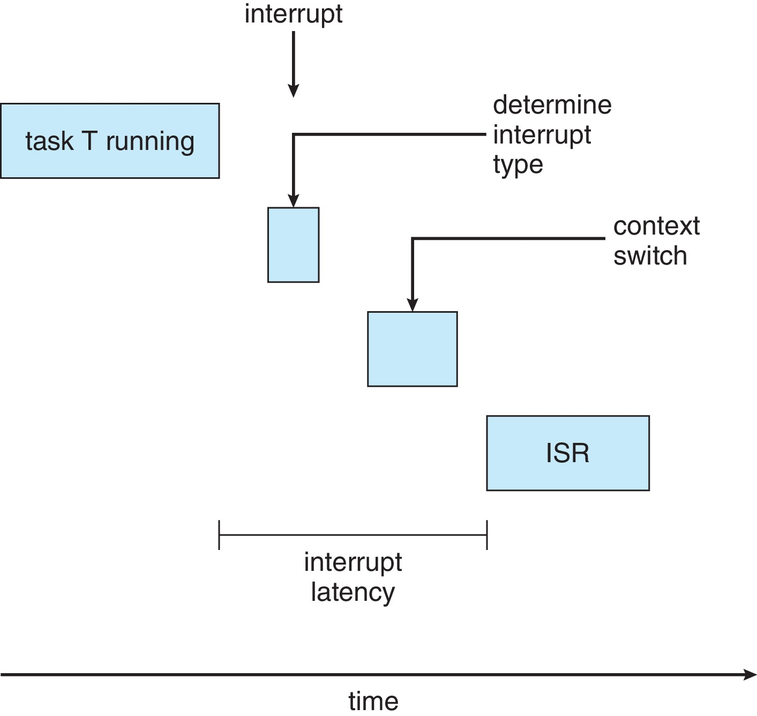
Interrupt Latency

Slide 46
End of Our syllabus from chapter 5

